Slide 1
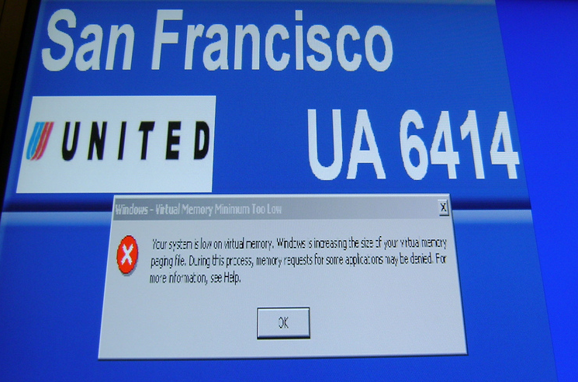
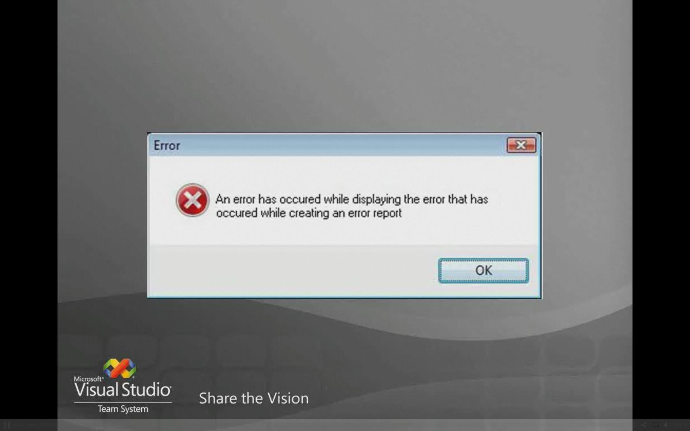
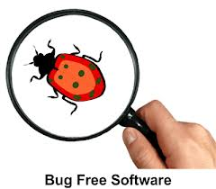
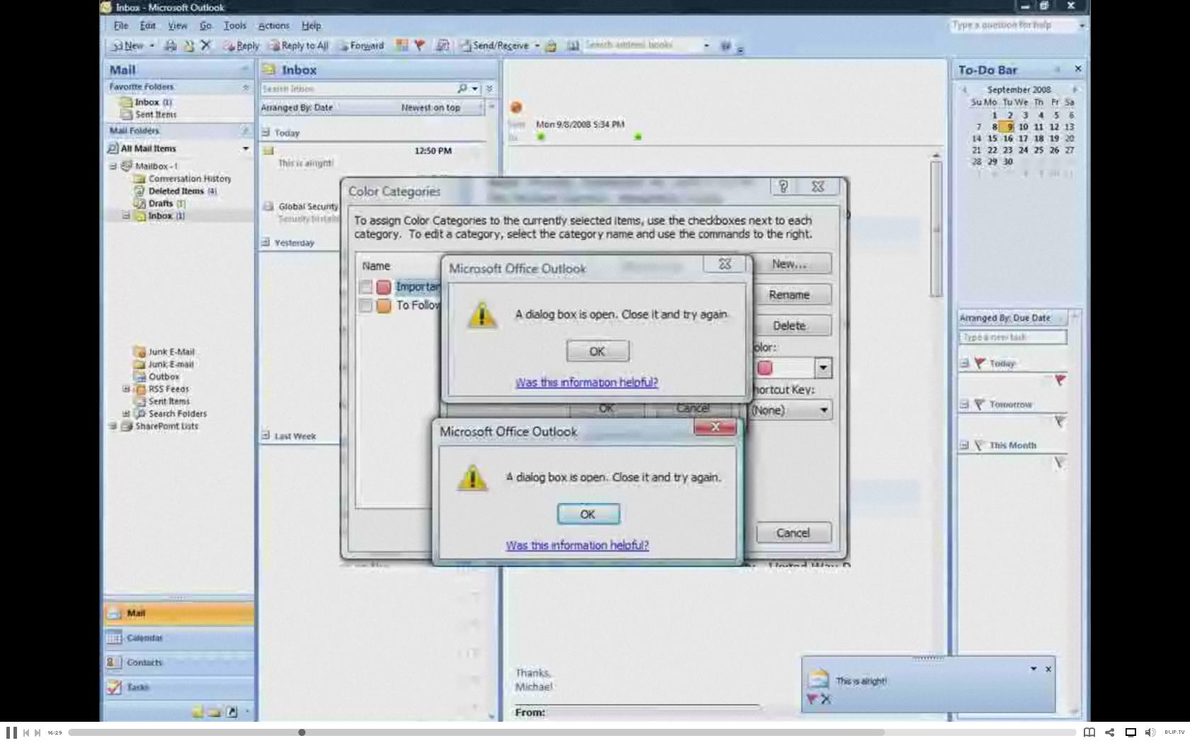
Software Testing
Lecture# 34

Slide 2
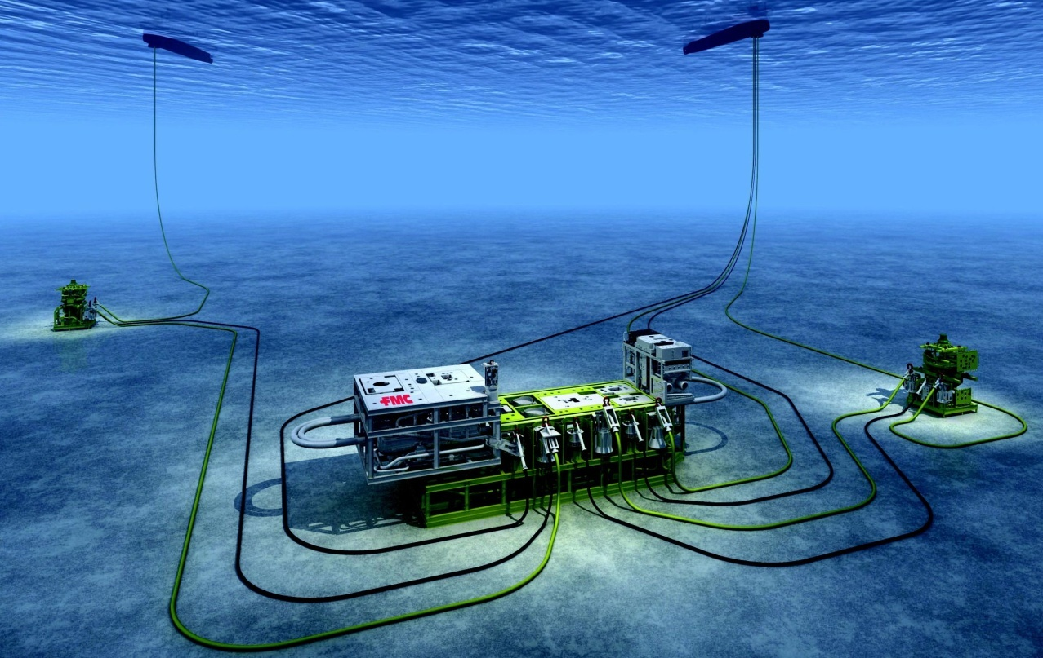
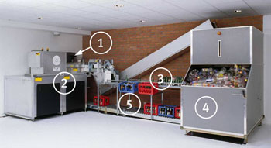
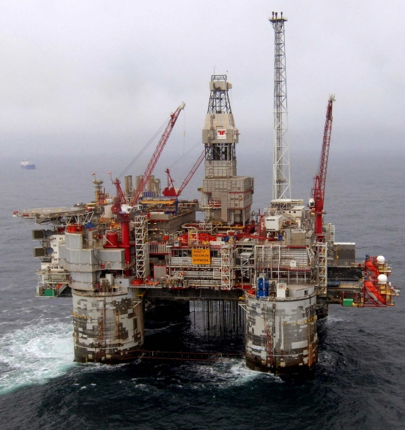
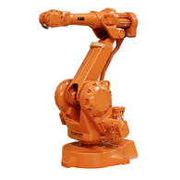
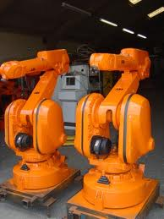
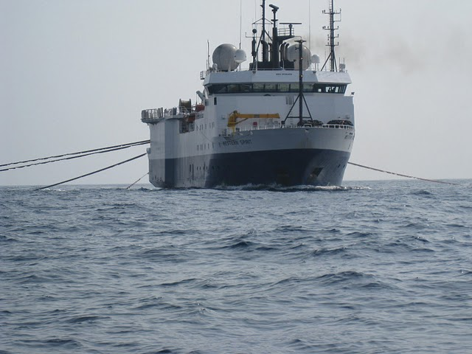
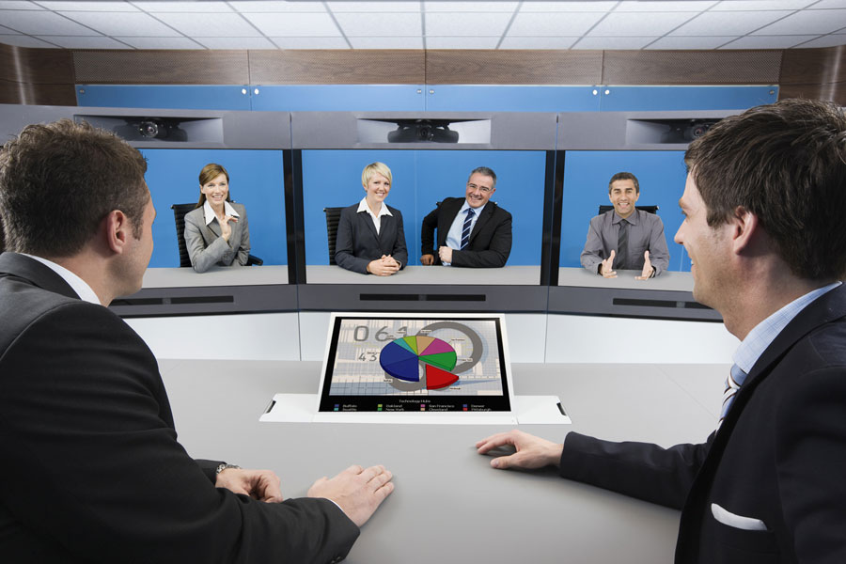
Software Everywhere
Notes:
2
Software is pervasive in our society
In all industries: automotive, aerospace, energy, administration, communication, medical, you name it
and software systems are getting increasingly more critical and more complex with time
In fact, though it is not apparent to most people, software is critical in nearly all our everyday activities, from transportation, banking, communication, entertainment, health …
In other words, software is the nervous system of all the systems that surround us
Windows, MacOS, Linux – Operating Systems.
Windows Media Player, iTunes, VLC media player – Playing rich media.
LambdaTest, Salesforce, Slack – SaaS – Software as a Service.
Avast, Kaspersky, Quickheal – Antivirus.
Every game you play from Candy Crush to GTA is also a software.

Slide 3
Why Testing and Analysis?
Software is never correct no matter which developing technique is used
Any software must be verified.
Software testing and analysis are:
important to control the quality of the product (and of the process)
very (often too) expensive
difficult and stimulating

Slide 4

Nature of Software Development
Human intensive
Engineering, but also social process
Increasingly complex software systems
Pervasive in an increasing number of industries
Notes:
Pervasive >>Persistent

Slide 5
Errors
Errors are part of our daily life
Humans make errors in their thoughts, actions, and in the products that might result from their actions
Errors occur wherever humans are involved in taking actions and making decisions
These fundamental facts of human existence make testing an essential activity

Slide 6
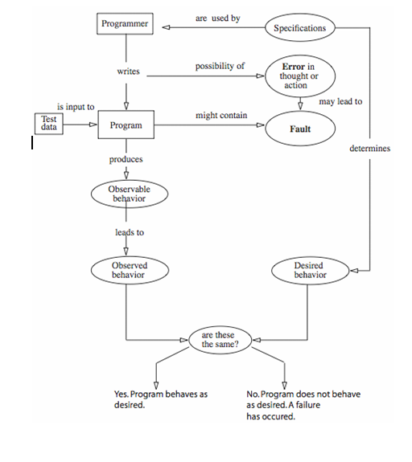
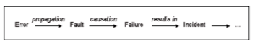
Software Error, Fault, Failure
If not
removed
Defect

Slide 7


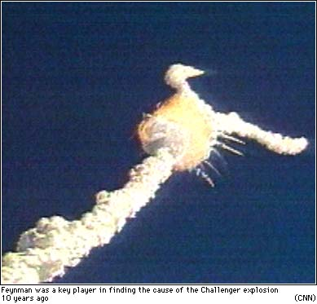
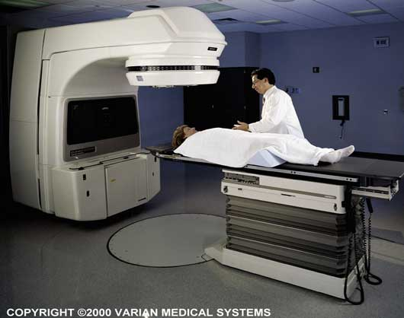

Failures Everywhere …
Notes:
Unfortunately software failures also occur everywhere
There is even a dedicated web site for computer-related risks, with failures being reported every month
Most of them are however not made public, for obvious reasons, but nevertheless result in significant financial consequences
Some of them, fortunately much rarer, have dramatic consequences on people and the environment
In 2002, NIST estimated the direct cost of failures in the US alone to be around 22 Billions (2002)
It has probably increased many folds since …

Slide 8
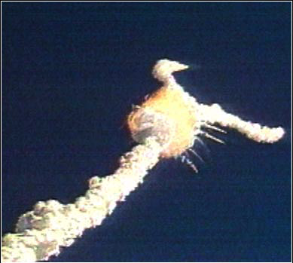
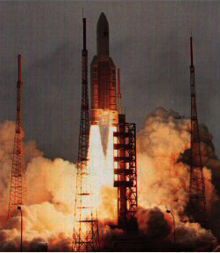
Ariane 5
Development took 10 years & $7 billion
On June 4, 1996, the flight of the Ariane 5 launcher ended in a failure
Only about 37 seconds after initiation of the flight sequence, at an altitude of about 3,700 m, the launcher veered off its flight path, broke up and exploded
“Fixed” Ariane 5 – currently being used
Notes:
It took the European Space Agency 10 years and $7 billion to produce Ariane 5, a giant rocket capable of hurling a pair of three-ton satellites into orbit with each launch and intended to give Europe overwhelming supremacy in the commercial space business. All it took to explode that rocket less than a minute into its maiden ...

Slide 9
Ariane 5 – Root Cause
Source: ARIANE 5 Flight 501 Failure, Report by the Inquiry Board
A program segment for converting a floating point number to a signed 16 bit integer was executed with an input data value of a 64-bit number.
The segment was written for Ariane 4 and the conversion was left unprotected, because it was thought that Ariane 4 will never attain such a value.
The subsystem containing this segment was reused for Ariane 5 as it had been successfully used over years for Ariane 4
This run time error (out of range, overflow), which arose in both the active and the backup computers at about the same time, was detected and both computers shut themselves down.
This resulted in the total loss of altitude control. This breakup was detected by an on-board monitor which ignited the explosive charges to destroy the vehicle in the air.
Ironically, this program segment was not required by Ariane 5
Notes:
Error: total loss of “attitude” > Altitude

Slide 10
Ariane 5 – Lessons Learned
Adequate exception handling and redundancy strategies (real function of a backup system, degraded modes?)
Clear, complete, documented specifications (e.g., preconditions, post-conditions)
But perhaps more importantly: usage-based testing (based on operational profiles), in this case actual Ariane 5 trajectories
Note this was not a complex, computing problem, but a deficiency of the software engineering practices in place …

Slide 11
F-18 crash
An F-18 crashed because of a missing exception condition:
An if ... then ... block without the else clause that was thought could not possibly arise.
In simulation, an F-16 program bug caused the virtual plane to flip over whenever it crossed the equator, as a result of a missing minus sign to indicate south latitude.
Notes:
flip over >> capsize

Slide 12
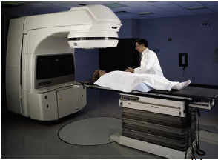
Fatal Therac-25 Radiation
In 1986, a man in Texas received between 16,500-25,000 radiations in less than 10 sec, over an area of about 1 cm.
He lost his left arm, and died of complications 5 months later.

Slide 13
Therac 25
Incident: A patient passed away
Failure: The device applied higher frequency of radiations than what was safe. Safety range: [1…10,000 Hz]
Fault: The software controller of the device did not have a conditional block (if …. else statements) to perform range checking on the frequency of the radiation to be applied.
Errors:
1. The SW developer of the device controller system had forgotten to include a range checking conditional block on the frequency of the radiation to be applied.
2. The device operator was NOT supposed to enter anything outside [1…10,000 Hz] range.

Slide 14
Testing Strategies
SW testing is one element of a broader topic referred to as V&V (many SQA activities).
Verification (correctly implement specific function)
Defect detection and correction
Comparison between implementation and the corresponding specification
Are we building the product right?
Validation (SW is traceable to customer requirements)
Defect prevention
Provision of sound basis for specific design decisions
Are we building the right product?
Example: Checking the printing of receipts is verification and correct printing (info) is validation.
Notes:
Lec 34 [2018]

Slide 15
Types/Strategies of testing
Code Inspections
Software (Module) Testing
Unit Testing
Functional Testing
Integration Testing
Compliance
Interoperability Testing
System Testing
Recovery
Security
Environment
Acceptance Testing and Release Testing
Regression Testing
Stress, Security, performance, Load Testing etc

Slide 16
Software Testing
A better definition: ”the process of running software with the intent of finding an error”.
The way most testing works is to input a set of values, then compare the expected result with the out comes/computed ones.
Depending on the type of data input, we can identify three levels of program correctness possible, probable, and absolute correctness.

Slide 17
Three Levels of Correctness
Possible correctness
Obtaining correct output for some arbitrary input (single set).
If the outcome is wrong, the program cannot possibly be correct.
For example a multiply program: for input 2 and 3, if result is 6; is possibly correct.
Probable correctness
Obtaining correct output for a number of carefully selected inputs.
If all potential problematic areas are checked in this way, the program is probably correct.
Try several values, including the obvious “problem” values such as zero, largest negative, 1, -1 and so on.

Slide 18
Absolute correctness
can be demonstrated only by a test that involves every possible combination of inputs.
Requires huge amount of time; it is therefore not practical {However for some programs we can prove correctness mathematically}.
Imagine the same above test for a 32 bit machine (how many combinations are possible? (Hundreds of Millions).

Slide 19
Testing in the 21st Century
Software defines behavior
network routers, finance, switching networks, other infrastructure
Today’s software market :
is much bigger
is more competitive
has more users
Embedded Control Applications
airplanes, air traffic control
spaceships
watches
ovens
remote controllers
Agile processes put increased pressure on testers
Programmers must unit test – with no training or education!
Tests are key to functional requirements – but who builds those tests ?
Industry is going through a revolution in what testing means to the success of software products
PDAs
memory seats
DVD players
garage door openers
cell phones

Slide 20
Software Faults, Errors & Failures
Software Fault : A static defect in the software
Software Failure : External, incorrect behavior with respect to the requirements or other description of the expected behavior
Software Error : An incorrect internal state that is the manifestation of some fault
Faults in software are equivalent to design mistakes in hardware.
Software does not degrade.

Slide 21
Fault and Failure Example
A patient gives a doctor a list of symptoms
Failures
The doctor tries to diagnose the root cause, the ailment
Fault
The doctor may look for anomalous internal conditions (high blood pressure, irregular heartbeat, bacteria in the blood stream)
Errors
Most medical problems result from external attacks (bacteria, viruses) or physical degradation as we age.
Software faults were there at the beginning and do not “appear” when a part wears out.

Slide 22
Testing Goals Based on Test Process Maturity
Level 0 : There’s no difference between testing and debugging
Level 1 : The purpose of testing is to show correctness
Level 2 : The purpose of testing is to show that the software doesn’t work
Level 3 : The purpose of testing is not to prove anything specific, but to reduce the risk of using the software
Level 4 : Testing is a mental discipline that helps all IT professionals develop higher quality software

Slide 23
Testing Methodologies
Black Box Testing
White Box Testing

Slide 24
Testing Methodologies
Black Box Testing: no knowledge of internal program design or code required.
Tests are based on requirements and functionality
White Box Testing: knowledge of internal program design and code are required.
Tests are based on coverage of code statements, branches, paths, conditions.
Notes:
White box testing: Line to line testing of the code
Black box testing: Based on inputs and outputs.
Black box testing examples
Decision Table Testing.
Graph-Based Testing.
Error Guessing Technique.
White box testing examples
Basis Path Testing:
Data Flow Testing : data flow testing
Path Testing:
Loop Testing

